Slide 1
COMPANY CREDENTIAL
Results Management Group
Digital Advertising | Online Marketing Solutions

Slide 2
ARE YOU LOOKING FOR MEDIA PARTNER?
ABOUT
US
We are what we repeatedly do.

Slide 3
ONLINE ADVERTISING
MEASUREMENT
VALUABLE
ATTRACT THE RIGHT AUDIENCE
GENERATE LEAD
GENERATE ONLINE SALE

Slide 4
ABOUT
US

Slide 5
WELCOME MESSAGE
“We are Specialist in Digital Advertising online marketing solution and Biddable Media. As 9 Years Experienced on Adwords Expert, We have managed 100+ Adwords Account , more than 300 Campaign over THB 30 Million of ad spends”
— Charkorn Tayapiwatana
Executive Director
Results Management Group

Slide 6
OUR COMPANY’S TIMELINE
2016
JOINT VENTURE
We are joint venture with BRILLIANT CONNECT as digital media partner
Results Management Group
2001 BEGINNING,
RMG was founded in 2001 as an digital media agency that support the large agency in Thailand
2017 We opened ADSTIVATE brand as Online marketing consultant for direct client or Small Business
VDO Production, digital advertising, web development and design, SEO and social media management

Slide 7
AGENCY CONSULTANT
Campaign Strategy
Campaign Bidding
Planning Media
Campaign Measurement
We plan, optimize and manage your SEM/FB Campaign analyze performance and manage your digital strategy to achieve your KPI .

Slide 8
WHAT
WE OFFER YOU

Slide 9
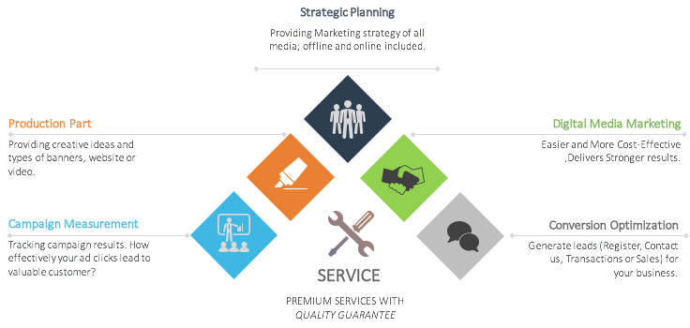
OUR SERVICE
Strongly provide with high performing.
Strategic Planning
Providing Marketing Strategy of all
Media; Offline and online included
Production Part
Digital Media Marketing
Providing Creative ideas and
Types of banners, website or video
Easier and More Cost-Effective
,Delivers Stronger results.
Campaign Measurement
Conversion Optimization
Tracking campaign results. How
Effectively your ad clicks lead to valuable customer
Generate leads (Register, Contact us,
Transactions or Sales) for
Your business.
PREMIUM SERVICES WITH
QUALITY GURANTEE

Slide 10
OUR SERVICE
Manage and Optimize campaigns
Facebook Page PR
Coordinate with Facebook page
Owner which influenced.
For reaching your audience.
Paid Media Management
Manage and Control your budget for maximum benefit.
Content Creator
Providing for Facebook page,
Websites and others platform.
Influencers
Coordinate with people who
Influence with consumers.
Google Analytics
Measure your websites and
Analyze your data.
Programmatic
Provides 3rd party platform for
Tracking campaign performance

Slide 11
SOCIAL MONITORING
YOUR
BRAND

Slide 14
OUR
CERTIFI CATION

Slide 15
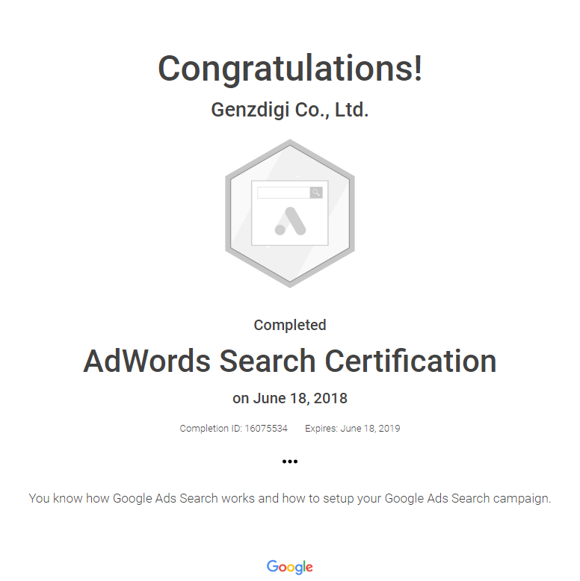
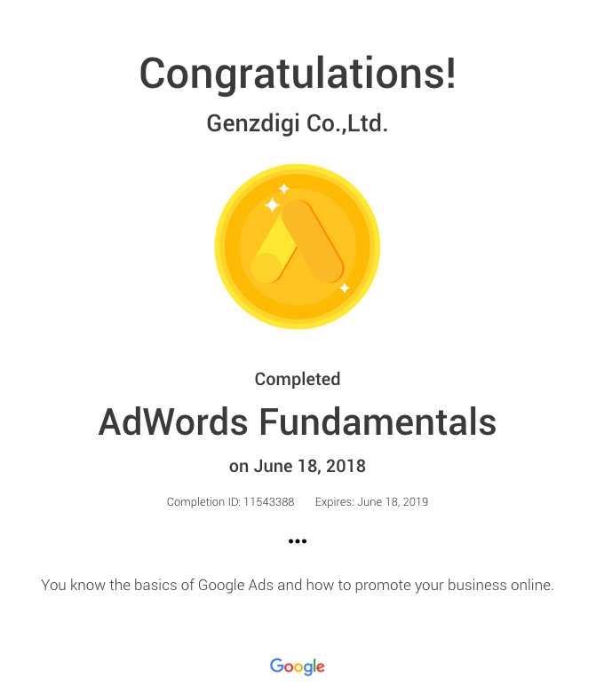
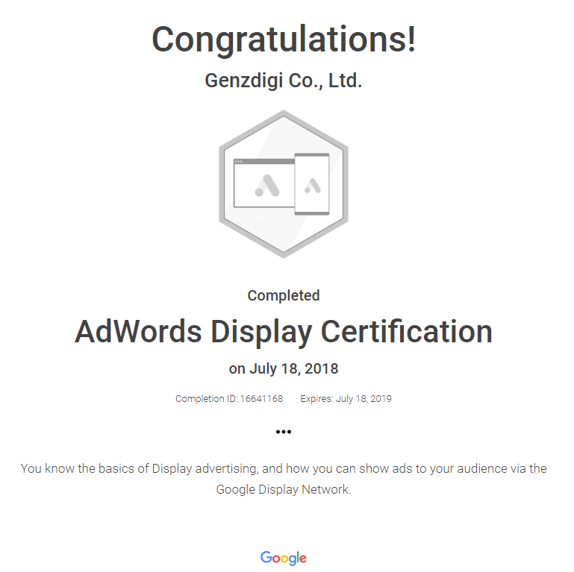
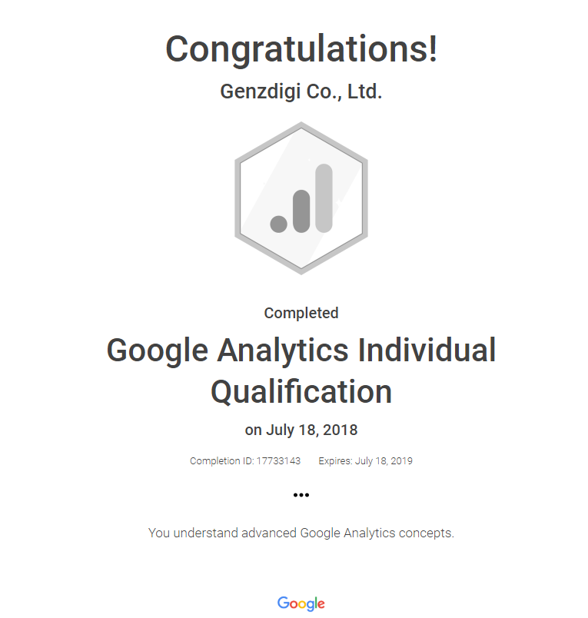

Slide 16
OUR PROPERTY’s
CLIENT

Slide 17
TIMELINE
2016 JAN-SEP
2015 SEP-DEC
PRUKSA LAND GDN, REMARKETING
THE PALM PATONG GDN
PRUKSA LAND GDN ON YOUTUBE, REMARKETING
PRUKSA THE TREE CONDO SEM , GDN , REMARKETING PRUKSA BEST BUY GDN
PRUKSA 100 PROJECT GDN , REMARKETING
BUDGET 1,101,660 THB
GET 108,066 CLICKS
AWARENESS 51,944,592
BUDGET 800,000 THB
GET 78,764 CLICKS
AWARENESS 31,285,244

Slide 18
2017 FEB , JUL
2017 JUN-JUL
HOME BUILDER EXPO YOUTUBE BUMPER AD
HOME BUILDER EXPO YOUTUBE IN-STREAM AD
PRUKSA THE PLANT RESORT RAMA5 SEM
BUDGET 200,000 THB
GET 77,000 VIEWS
AWARENESS 765,052
BUDGET 25,000 THB
GET 1,672 CLICKS
AWARENESS 44,492
2017 AUG
2017 JUL-OCT
SIAMESE SUKHUMVIT 24 SEM
NEWERA CONDO SEM , GDN
BUDGET 80,000 THB
GET 3,500 CLICKS
AWARENESS 145,366
BUDGET 200,000 THB
GET 7,000 CLICKS
AWARENESS 190,805
2017 AUG (20 DAYS)
2017 DEC
GRAND UNITY แช่แข็งเงินผ่อน
LPN SEAVIEW CHA-AM
BUDGET 900,000 THB
GET 2,000 LEAD GENERATION
BUDGET 80,000 THB
GET 4,000 CLICKS
AWARENESS 90,685

Slide 19
2018 FEB-AUG
2018 APR-DEC
LUMPINI TOWNSHIP SEM
LPN CHINESE NEW YEAR SEM LUMPINI SEA VIEW CHAAM SEM LPN CONDO FOR RENT SEM BAAN LUMPINI SEM BAAN 365 SEM , GDN
THE STRAND CONDOMINIUM SEM , GDN
BUDGET 290,000 THB
GET 22,000 CLICKS
AWARENESS 5,293,512
BUDGET 554,000 THB
GET 39,272 CLICKS
AWARENESS 4,198,702
2018 AUG-DEC
JEWELLERY BUILDING SEM
BUDGET 108,000 THB
GET 1,563 CLICKS
AWARENESS 32,328

Slide 20
OUR EXPERTISE – CONTENT STRATEGY

Slide 21
MEET OUR
CLIENT

Slide 22
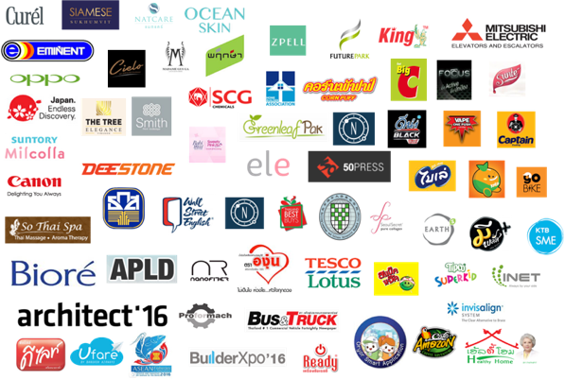
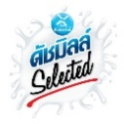

Slide 23
OUR EXPERTISE - EXHIBITION
Arhitect’16
GDN campaign Click : 17,928
CTR : 0.33% Avg.
Period : Mar-Apr, 2016
Thailand Best Buys
GDN campaign Click : 11,199
CTR : 0.29% Avg.
Period : Sep- Dec, 2016
ASEAN Fisheries
SEM campaign Click : 1,104
CTR : 2.30% Avg.
Period : May-Jun, 2016
Thai Exhibition Association
SEM campaign
Click : 2,188
CTR : 6.28% Avg.
Period : Dec, 2016-Jun, 2017

Slide 24
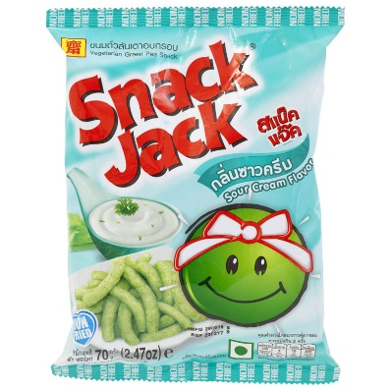
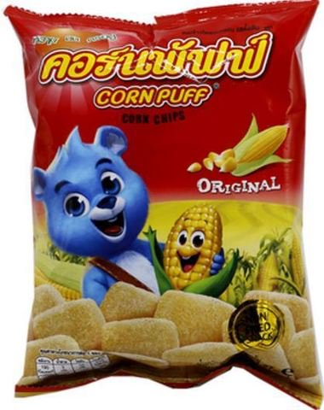
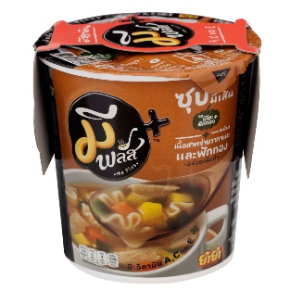
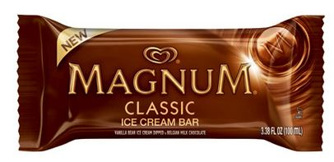
OUR EXPERTISE - FOOD
Snack Jack
GDN campaign Click : 18,783
CTR : 7.30% Avg.
Period : Aug-Oct, 2016
Deksomboon
GDN campaign
Click : 5,246
CTR : 0.22% Avg.
Period : Sep-Oct, 2015
Cornpuff
GDN campaign
Click : 15,227
CTR : 0.26% Avg.
Period : Dec2016 -Mar, 2017
Me Plus
YouTube in-stream campaign
View : 70,128 VTR : 31.59%
Period : Jul-Aug, 2016
King Rice Oil
GDN campaign
Click : 16,902
CTR : 0.24% Avg.
Period : Sep-Dec, 2016
Magnum
SEM campaign Click : 2,059
CTR : 4.15% Avg.
Period : Dec2016-Feb, 2016
Angoon
GDN campaign
Click : 31,380
CTR : 0.21% Avg.
Period : Feb-May, 2016

Slide 25
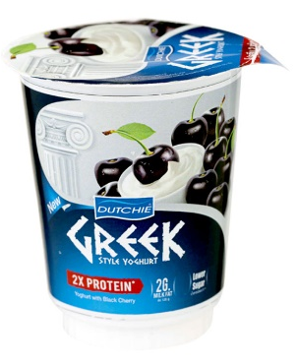
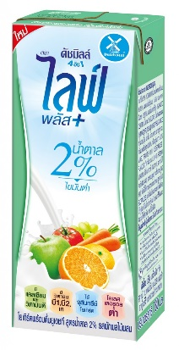
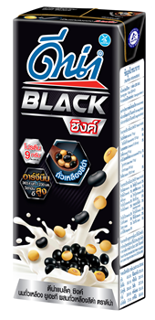
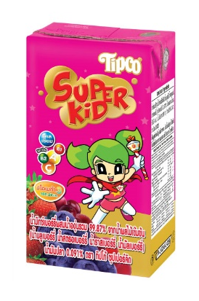
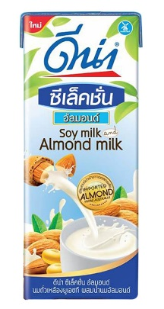
OUR EXPERTISE - BEVERAGES
Kato
SEM campaign Click : 1,670
CTR : 1.97% Avg.
Period : Feb-Mar, 2016
Dutchie Greek
GDN campaign Click : 5,305
CTR : 0.17% Avg.
Period : Jun-Jul, 2016
Birelry
GDN campaign
Click : 10,119
CTR : 0.20% Avg.
Period : Sep, 2016
Dutchmill Life+
SEM campaign Click : 2,018
CTR : 5.15% Avg.
Period : May, 2017
DNA Black Zinc
GDN campaign
Click : 12,562
CTR : 0.24% Avg.
Period : Apr-Jul, 2016
Tipco Superkid
YouTube in-stream campaign
View : 25,233 VTR : 25.54%
Period : Mar-May, 2016
DNA Selection Almond
GDN campaign
Click : 7,584
CTR : 0.45% Avg.
Period : Oct-Nov, 2016
ReadyZaa
GDN campaign
Click : 6,536
CTR : 0.31% Avg.
Period : Feb-Mar, 2016

Slide 26
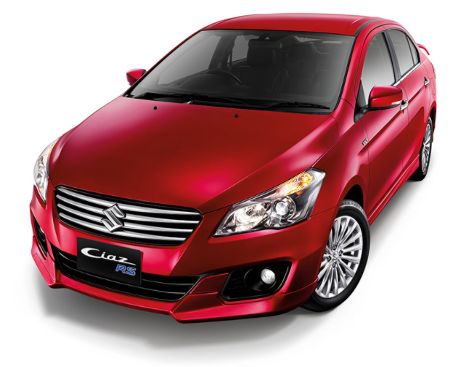
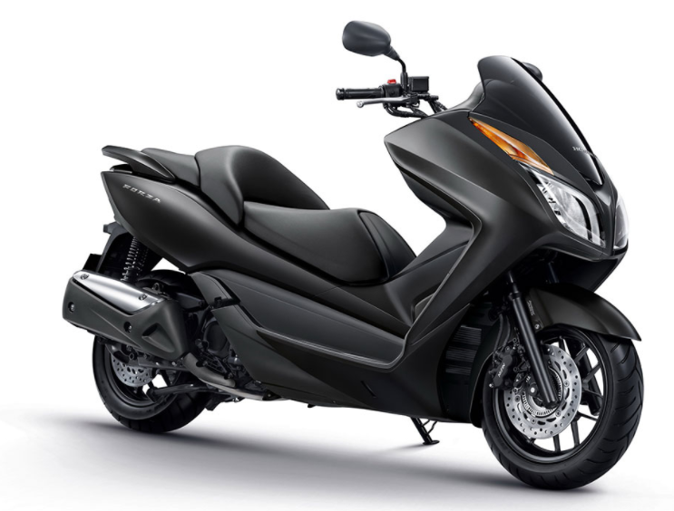
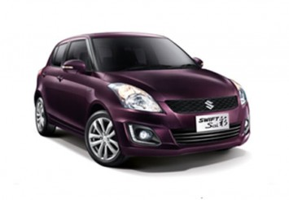
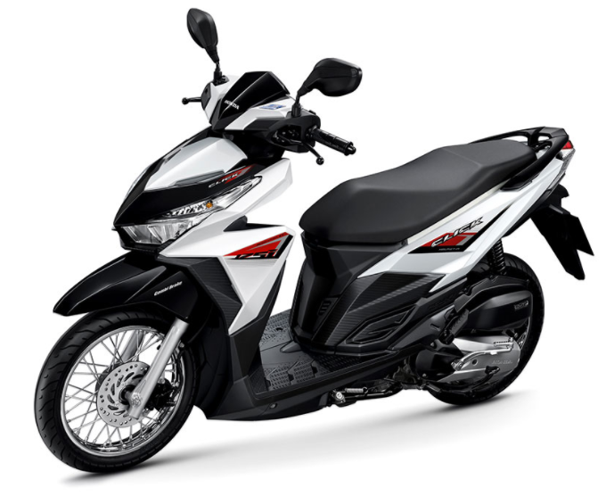
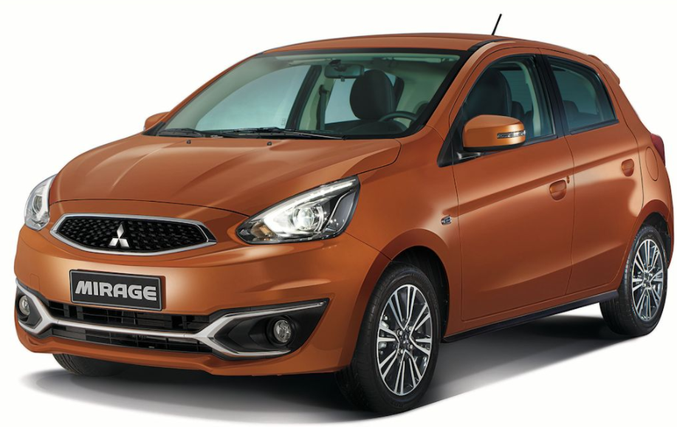
OUR EXPERTISE - AUTO
Suzuki Ciaz RS
SEM campaign
CTR : 7.30%
Avg. position : 2.1
Period : Jun-Dec, 2015
Honda Forza 300
SEM campaign
CTR : 5.64%
Avg. position : 1.4
Period : Aug-Oct, 2015
Suzuki swift Sai
SEM campaign
CTR : 9.27%
Avg. position : 1.4
Period : Mar-May, 2016
Honda Click 125i
SEM campaign
CTR : 5.52%
Avg. position : 1.7
Period : Sep, 2015
TSL Auto
Facebook BoostPost campaign
Reach : 252,586
Period : June, 2017
BikeMan
SEM campaign
CTR : 7.56%
Avg. position : 1.7
Period : Feb-Apr, 2018
Mitsubishi Mirage
YouTube in-stream campaign
VTR : 31.32%
Period : Aug-Sep, 2016

Slide 27
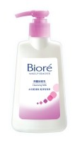
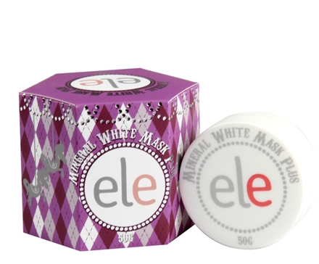
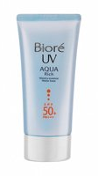
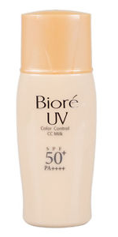
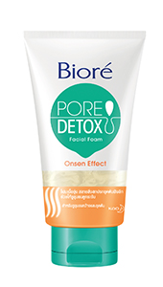
OUR EXPERTISE - BEAUTY
Biore Cleaning Water
SEM campaign Click : 7,881
CTR : 2.80% Avg.
Period : Jun, 2015 - Jan, 2016
Biore Cleaning Milk
SEM campaign Click : 6,216
CTR : 6.36% Avg.
Period : Mar-Apr, 2017
ELE
YouTube in-stream campaign
View : 182,894 VTR : 34.01%
Period : Nov-Dec, 2016
Biore uv aqua rich
SEM campaign Click : 14,085
CTR : 4.86% Avg.
Period : Aug- Nov, 2015
Curel
SEM campaign
Click : 30,296
CTR : 4.25% Avg.
Period : Aug, 2016-Mar, 2017
Biore UV CC Milk
SEM campaign
Click : 27,946
CTR : 2.80% Avg.
Period : Mar-Jun, 2015
Biore pore detox
SEM campaign
Click : 6,081
CTR : 6.94% Avg.
Period : Jan-Feb, 2017

Slide 28
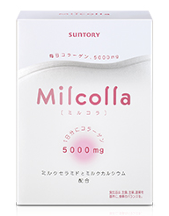
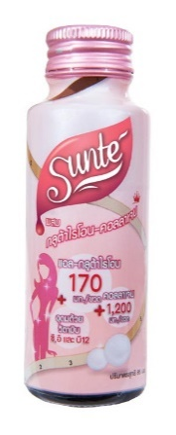
OUR EXPERTISE - BEAUTY
Smith Prive’ Aestheetique
SEM campaign
Click : 8,090
CTR : 2.63% Avg.
Period : Sep-Oct, 2016
Suntory Milcolla
SEM campaign
Click : 128,366
CTR : 4.27% Avg.
Period : Jan, 2015–Feb, 2017
Sunte
GDN campaign
Click : 8,126
CTR : 0.18% Avg.
Period : Apr-Jun, 2016
Healthy Home
SEM campaign
Click : 4,530
CTR : 0.20% Avg.
Period : Jul, 2017
Natcare
SEM campaign
Click : 30,016
CTR : 6.15% Avg.
Period : Aug-Dec, 2016
Ocean Skin
GDN campaign
Click : 12,562
CTR : 0.24% Avg.
Period : Apr-Jul, 2016
EARTHs
GDN campaign
Click : 10,205
CTR : 0.32% Avg.
Period : Mar-Apr, 2017
Madame Gus Ga
GDN campaign
Click : 16,158
CTR : 0.20% Avg.
Period : Aug-Sep, 2016

Slide 29
OUR EXPERTISE - IT&GADGET
Canon EOS M10
SEM campaign
Click : 15,000
CTR : 7.62%
Period : Nov-Dec, 2015
Nikon1 J5
YouTube in-stream campaign
View : 63,943 VTR : 23.39%
Period : Mar, 2016
Canon EOS 80D
SEM campaign
Click : 38,732
CTR : 8.02%
Period : Apr-Sep, 2016
Oppo
SEM campaign
Click : 58,816
CTR : 7.86%
Period : Aug, 2015-Jan, 2016
Printer Canon
SEM campaign
Click : 38,456
CTR : 11.54%
Period : Nov, 2017 – Jan, 2018

Slide 30
OUR EXPERTISE - FINANCIAL & INSURANCE
ThaiLife
SEM campaign
Lead : 4,500
Period : Feb –Present
Carpool
SEM campaign
Lead : 174
Conv. Rate : 8.71%
Period : Apr, 2017
KTB
SEM campaign
Click : 11,116
CTR : 4.06%
Period : Aug-Sep, 2016
BAAC
SEM campaign
Click : 22,788
CTR : 0.23%
Period : Sep, 2015-Mar, 2017

Slide 31
OUR EXPERTISE - COMMUNICATION
3BB
SEM campaign Click : 4,167,176
CTR : 22.82% Avg.
Period : Nov, 2014 - Sep, 2017
INET
SEM campaign
Click : 20.480
CTR : 7.30% Avg.
Period : Jul-Aug, 2017

Slide 32
OUR EXPERTISE - B2B & TRANSPORTATION
Mitsubishi Elevator
SEM campaign Click : 3,694
CTR : 7.47% Avg.
Period : Oct, 2016 - May, 2018
DHL
SEM campaign
Click : 37,879
Conversion : 6,369
Period : May -Sep, 2017
Oryor Smart
GDN campaign Click : 4,641
CTR : 0.23% Avg.
Period : Apr- May, 2016
GDN campaign
Click : 15,522
CTR : 0.38% Avg.
Period : Oct, 2017
GoBike
YouTube Mobile App campaign
View : 40,869 VTR : 30.24%
Period : Feb, 2016
Bangkok Airways
SEM campaign
Click : 13,551
CTR : 5.06% Avg.
Period : May -Jun, 2016
Proformach
SEM campaign
Click : 1,313
CTR : 3.60%
Period : Jun-Aug, 2016
SCG Chemicals
SEM campaign
Click : 17,291
CTR : 2.62% Avg.
Period : Nov-Sep, 2016

Slide 33
OUR EXPERTISE – PRINTING & PUBLISHING
50 Press Printer
SEM campaign
Click : 16,000
CTR : 7.03% Avg.
Period : May,2017 – May 2018
Takage Press
SEM campaign
Click : 1,334
CTR : 8.45% Avg.
Period : Apr - June 2018

Slide 34
OUR EXPERTISE - OTHER INDUSTRY
Mitsubishi Elevator
SEM campaign Click : 3,694
CTR : 7.47% Avg.
Period : Oct, 2016 Sep, 2017
Eminent
SEM campaign Click : 55,181
CTR : 4.57% Avg.
Period : Jan, 2016- Jun, 2017
Vape One Push
GDN campaign Click : 22,602
CTR : 0.29% Avg.
Period : Jun, 2016 - Jan, 2017
NR Nanofiber
SEM campaign
Click : 1,233
CTR : 3.79% Avg.
Period : Jun-July, 2016
Opple
GDN campaign
Click : 23,493
CTR : 0.39% Avg.
Period : Dec, 2016-Mar, 2017
Hitachi
SEM campaign
Click : 30,297
CTR : 5.90% Avg.
Period : Jan-May, 2017
Titoni
GDN campaign Click : 5,173
CTR : 0.56% Avg.
Period : Feb, 2017

Slide 35
OUR EXPERTISE - OTHER INDUSTRY
Captain
SEM campaign
Click : 62,404
CTR : 7.60%
Period : Oct, 2016 –Jun, 2017
Wa Theater
SEM campaign
Click : 1,233
CTR : 3.79% Avg.
Period : Jun-July, 2016
Jigsaw English
SEM campaign
Click : 2,000
CTR : 10.29 %
Period : Apr-May, 2018
Villa De Bua
SEM campaign
Click : 10,000
CTR : 7.86% Avg.
Period : May-July, 2018
My One Class
SEM campaign
Click : 12,000
CTR : 10.24%
Period : Apr-Sep, 2018
Tesco Lotus
GDN campaign
Click : 20.480
CTR : 0.20% Avg.
Period :Apr, 2016 May, 2017
Deestone
GDN campaign
Click : 8,835
CTR : 1.78%
Period : Apr-Mar, 2015
Cielo Sky Bar
SEM campaign
Click : 6,859
CTR : 3.01%
Period : Dec, 2016, Jan, 2017

Slide 36
GET
IN
TOUCH

Slide 37
GET IN TOUCH
Send us a message or visit us
Whenever you like
Charkorn Tayapiwatana
Executive DIRECTOR
+ 66 (81) 802-8024
Charkorn@rmg.co.th
visit us www.rmg.co.th

